Slide 1

Data Warehouse
A complete process to data visualization
ELENI RALLI (f2822312)
ANNA PAPADIMITRIOU (f2822311)

Slide 2
The first column in the excel is just the number of the row, without header.
CustomerID
Gender
Location
Tenure_Months
Transaction_ID
Transaction_Date
Product_SKU
Product_Description
Product_Category
Quantity
Avg_Price
Delivery_Charges
Coupon_Status
GST
Offline_Spend
Online_Spend
Month
Date
Coupon_Code
Discount_pct
ONLINE SHOPPING DATASET
21Columns
52956 Rows
1 CSV File
Source: Kaggle

Slide 3
MULTIDIMENSIONAL MODELING PROCESS
According to Kimball
01
02
03
04
Choose the business processes to model:
Transaction Analysis
Choose the granularity of the business process:
Product-Line Level Granularity
Customer-Level Analysis
Design the dimensions and the fact table.
Choose the measures:
Quantitative Measures
Derived Measures

Slide 4
CREATE STAGING TABLE
IMPORT CSV FILE TO SSMS
E-T-L
CREATE BACKUP TABLE
REMOVE UNNECESSARY COLUMNS
PROCESS
CONVERT DATA TYPES
HANDLE MISSING DATA
HANDLE LOCATION HIERARCHY

Slide 5
HANDLING LOCATION HIERARCHY
USA
NOT APPLICABLE
UNKNOWN CITY
CALIFORNIA
UNKNOWN CITY
NEW JERSEY
UNKNOWN CITY
NEW YORK
WASHINGTON DC
ILLINOIS
CHICAGO

Slide 6
SURROGATE KEYS
There are multiple products per transaction → multiple rows might share the same Transaction_ID
There are multiple transactions per CustomerID
There are duplicate CustomerID in the dataset
There are duplicate SKUs in the dataset
Surrogate keys are used in data warehousing for several reasons:
A surrogate key is a unique identifier for each row in a table, when natural keys might not be unique.
Natural keys can sometimes be NULL or duplicate, which can cause problems in relational integrity and joins.
Surrogate keys allow for the implementation of slowly changing dimensions, where historical data can be preserved alongside current data.

Slide 7
CREATING DIMENSIONS
We chose to make a snowflake schema.
maintaining data integrity
reducing redundancy
scalable and flexible system
CUSTOMER
DIMENSION​
Customer_created_ID​
Customer_ID​
Gender​
Tenure_Months​
Location_created_ID​
​
​
​
Use: customer profile analysis​
LOCATION SUB-DIMENSION
Location_created_ID
City
State
Country
Use:
demographic
segmentation
PRODUCT
DIMENSION
Product_created_ID
Product_SKU
Product_Description
Product_Category
Use:
product
performance analysis, inventory management
PROMOTION DIMENSION
Coupon_created_ID
Coupon_Code
Coupon_Status
Use:
marketing
effectiveness,
promotion analysis
TIME
DIMENSION
Transaction_Date_created_ID
Date
Day
Month
Year
Quarter
Use:
sales forecasting,
trend analysis, temporal patterns

Slide 8
DESIGNING
THE FACT TABLE
SALES FACT TABLE
Sales_created_ID
Transaction_ID
Customer_created_ID
Product_created_ID
Time_created_ID
Location_created_ID
Promotion_created_ID
Quantity
Avg_Price
Delivery_Charges
GST
Offline_Spend
Online_Spend
Discount_pct
Total_product_value
Quantitative Measures
• Use: To calculate total sales, profitability, and financial metrics at both product and transaction levels
Derived Measures
• Use: For detailed revenue tracking and profitability analysis

Slide 9

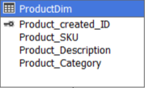
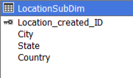
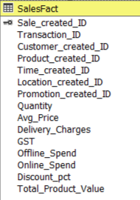
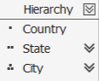
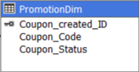
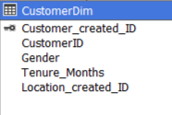
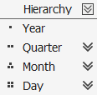
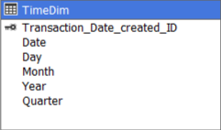
CUBE PROCESS
Location Sub-dimension unbalanced hierarchy
Time Dimension Hierarchy

Slide 10
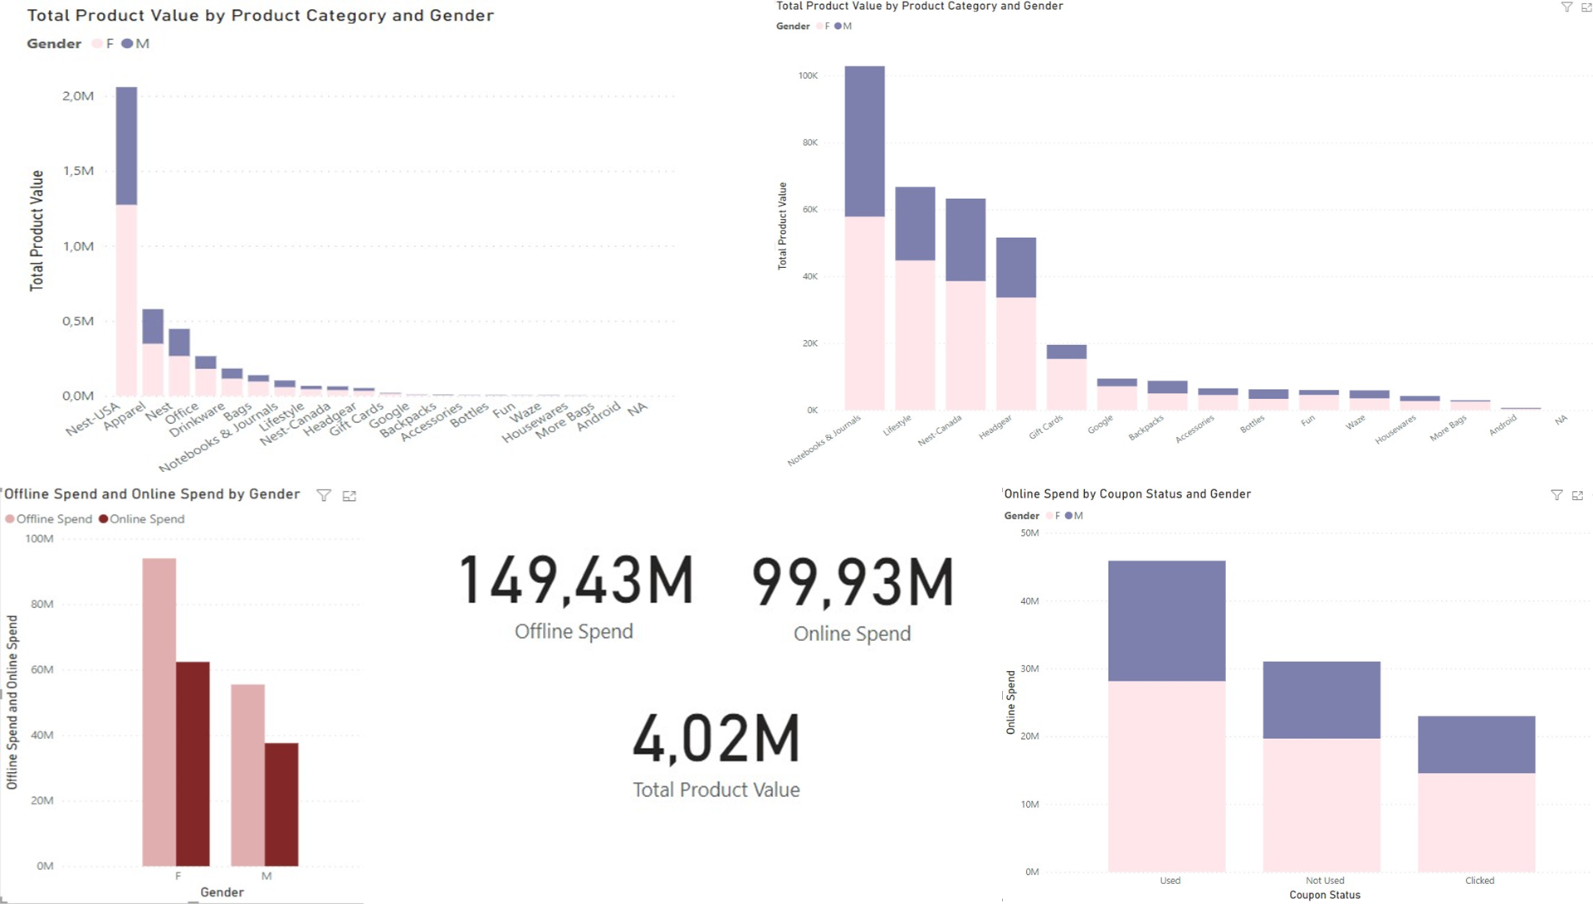

Slide 11
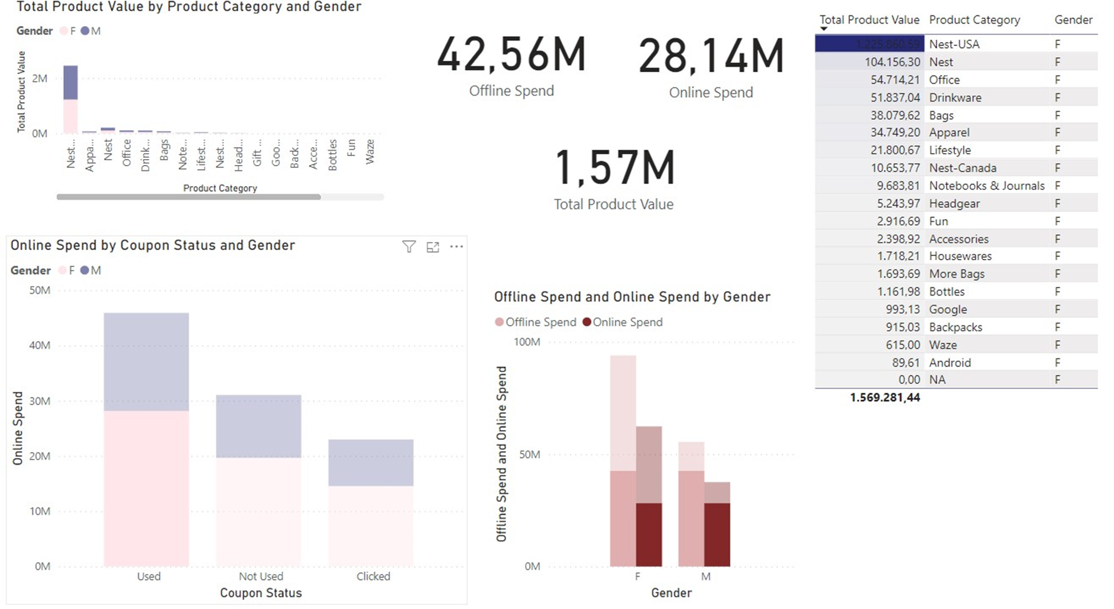

Slide 12
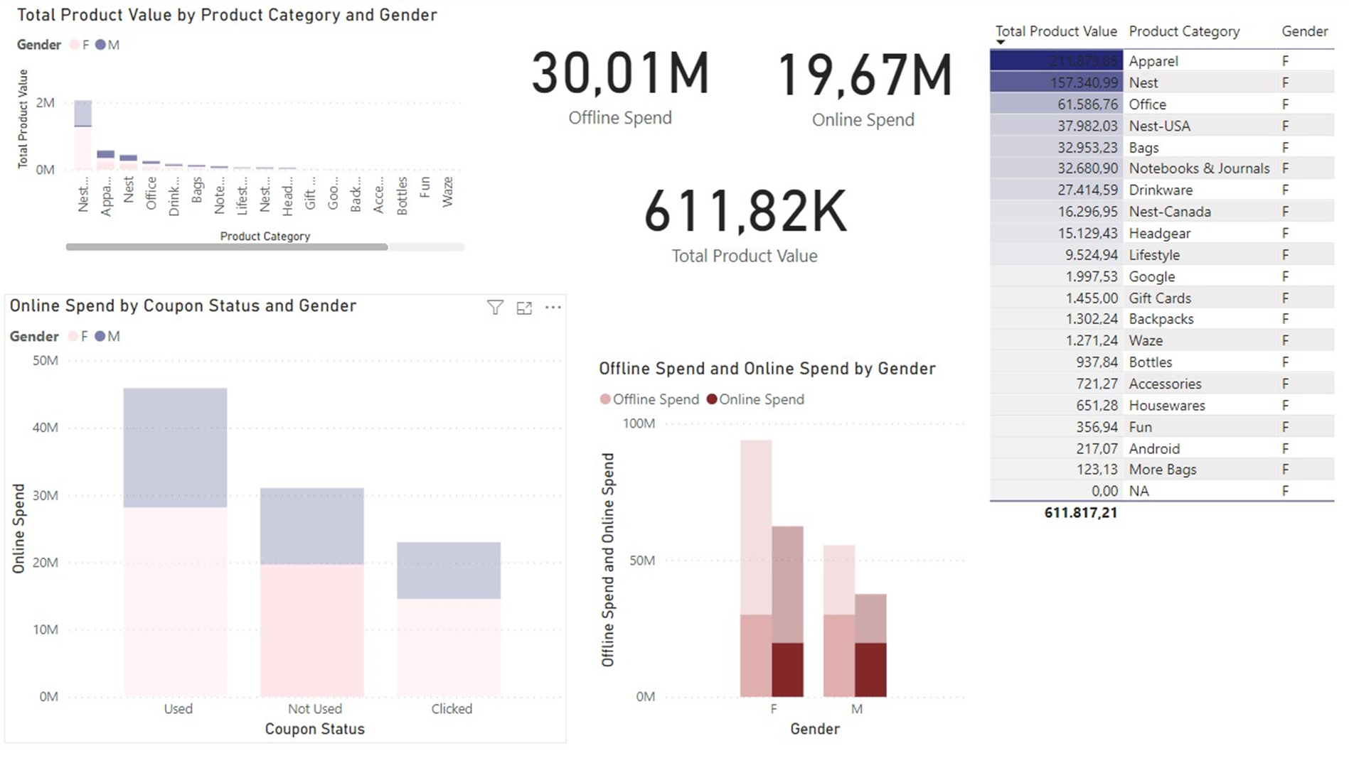

Slide 13
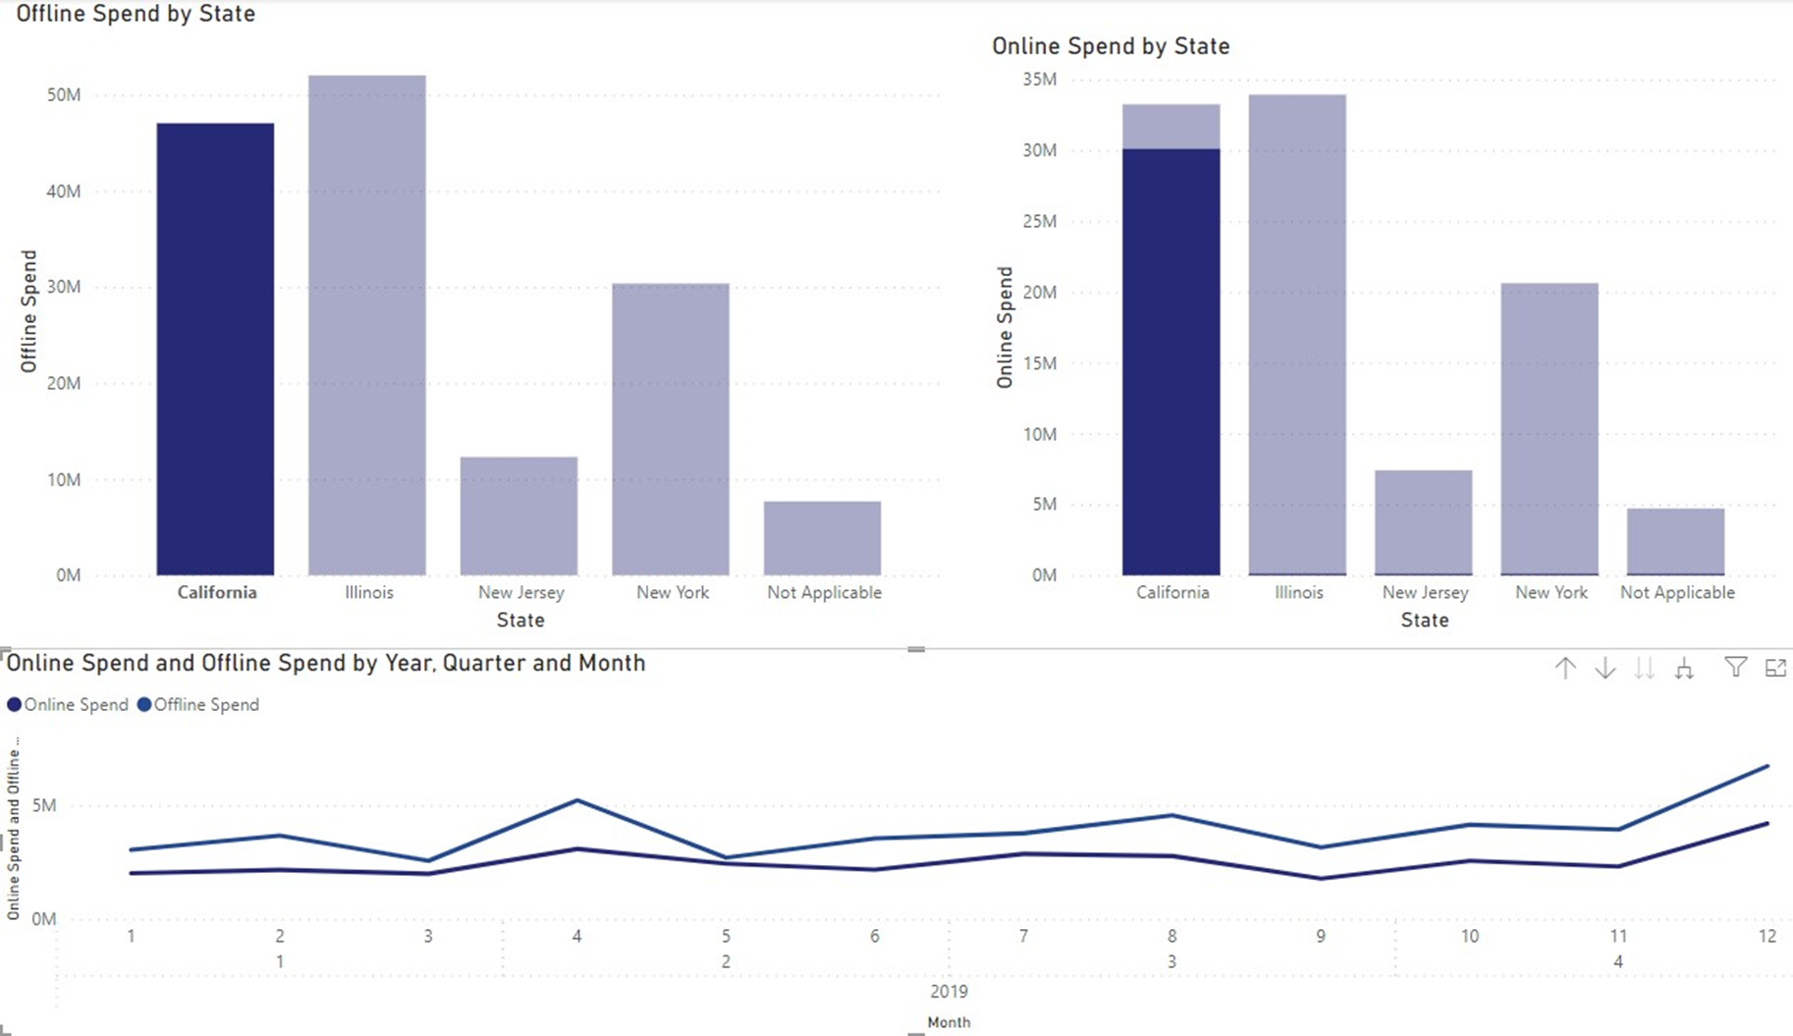

Slide 14
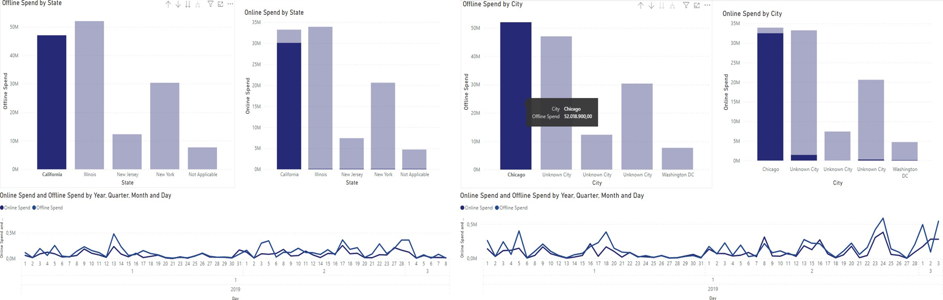

Slide 15
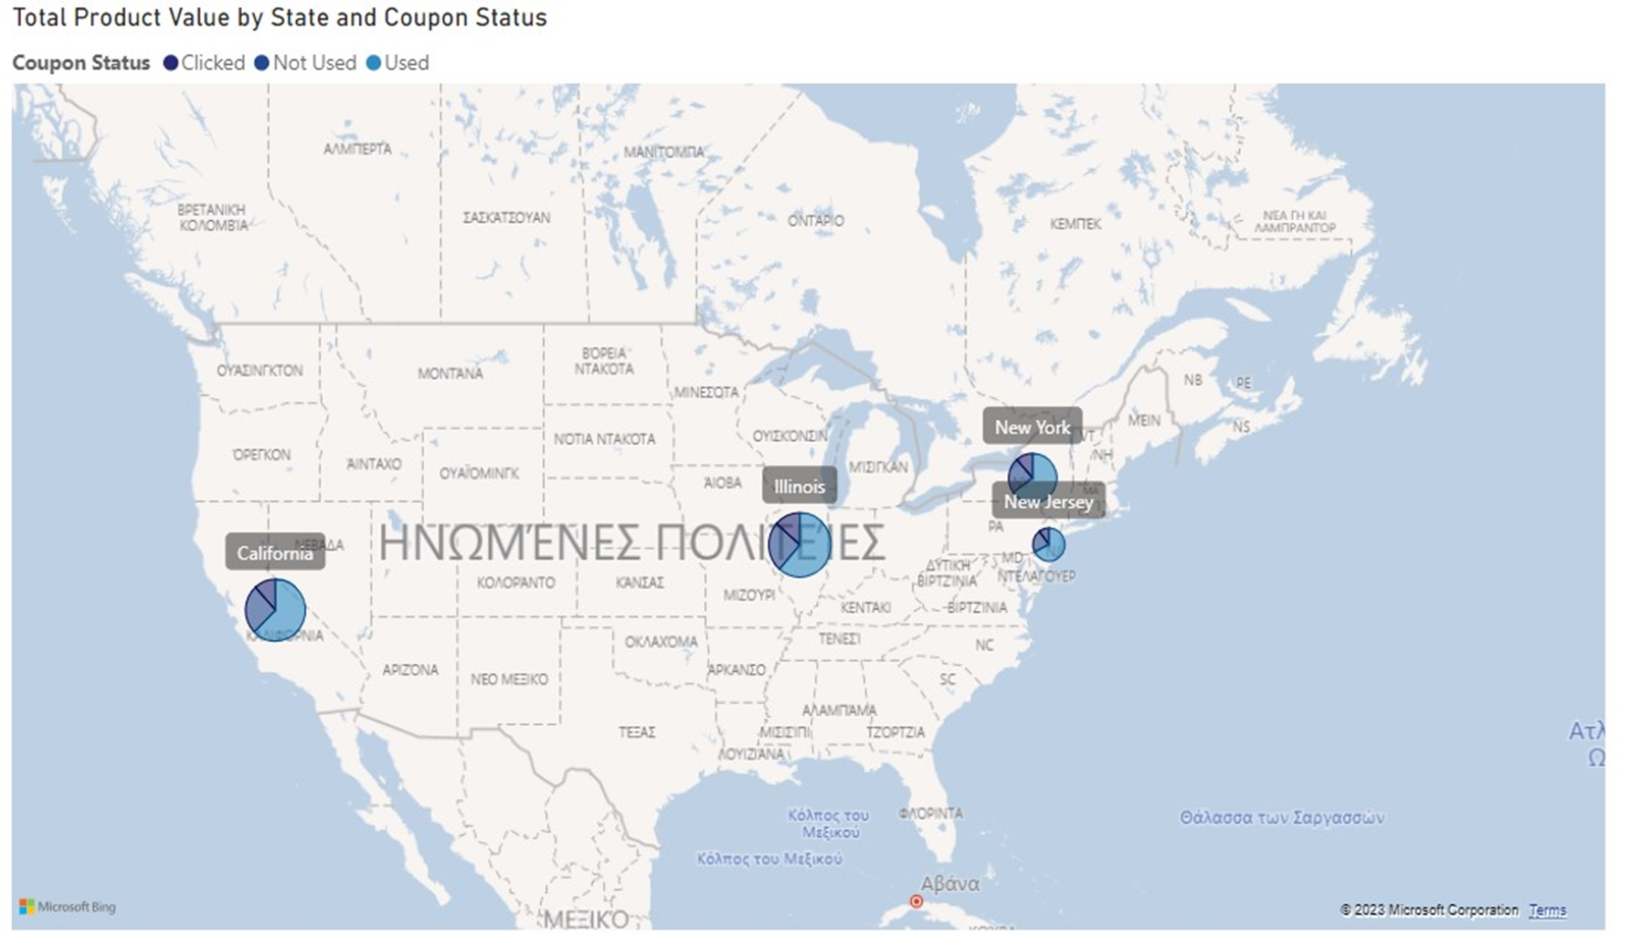

Slide 16
